Slide 1
Imitation Learning over Heterogeneous Agents with Restraining Bolt
Sapienza Università di Roma
Giulia Cassarà - Ivan Colantoni
Fabian Fonseca - Damiano Zappia
Reasoning Agents, May 2020

Slide 2
INTRODUCTION
01

Slide 3
A common problem in Reinforcement Learning (RL) is that the reward function is hard to express. This can be overcome by resorting to Inverse Reinforcement Learning (IRL).
Giulia Cassarà - Introduction

Slide 4
Problems
Typical IRL solutions rely on a numerical representation of the reward function.
Raises problems related to the adopted optimization procedures
Expert and the learner must share the representation space (states and actions)
In the paper they describe a IL method where the execution traces generated by the expert agent, possibly via planning, are used to produce a logical (as opposed to numerical) specification of the reward function.
Incorporated into a device known as a Restraining Bolt
Expert and learner and the RB using different representations of the environment’s actions and states
Giulia Cassarà - Introduction

Slide 5
IRL & IL
Reward function
Inverse Reinforcement Learning (IRL) consists in estimating a reward function from a set of traces captured during the execution of an agent’s policy.
In Imitation Learning (IL), an expert agent executes a possibly optimal policy, generating a set of execution traces which are exploited by a learning agent to reconstruct the reward function
Executes a possibly optimal policy
Execution traces
Reconstruction of the reward function
Expert Agent
Learner Agent
Learn a policy that imitates Expert
Giulia Cassarà - Introduction

Slide 6
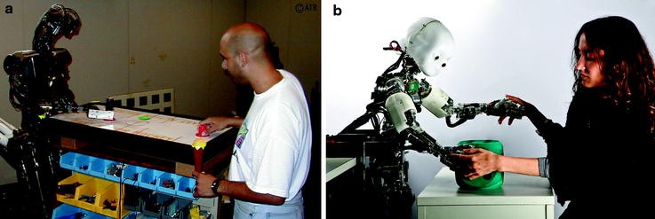
Expert and learner may be different kinds of agents, e.g., human and robot like in fig. a and b, executing tasks in different ways, i.e., with different action and perception abilities.
Giulia Cassarà - Introduction

Slide 7

Restraining Bolt
"Fit him with a restraining bolt and take him back to His Excellency's main audience chamber."
―EV-9D9, regarding C-3PO
Giulia Cassarà - Introduction

Slide 8
A Restraining Bolt is a device, with its own sensors, that can be attached to a Reinforcement Learning (RL) agent, to constrain its behavior and make it fulfill desired temporal high-level goals.
Such goals are expressed as formulas of linear-time temporal logic over finite traces, LDLf, over a set of fluents, generally different from the features used by the RL agent.
Giulia Cassarà - Introduction

Slide 9
The expert agent executes its policy, producing desired and undesired traces at its own representation level.
From these traces, we obtain a deterministic finite-state automaton (DFA) accepting all the positive (desired) traces and rejecting all the negative (undesired) ones.
The DFA thus represents (an approximation of) the expert’s behavior.
1
2
The DFA is incorporated in a RB, to make it learn a (possibly optimal) policy that imitates the expert’s behavior.
The low-level traces generated by the expert are transformed into high-level traces from the RB sensors
Once the high-level behavior is learned, this can be transferred to an agent with different capabilities.
3
Giulia Cassarà - Introduction

Slide 10
Other approaches
Most IRL solutions model the reward function in parametric form and use some optimization or regression method to optimize the parameter values.
The main issue with these approaches is that the optimization problem is essentially ill-posed.
Estimating numerical reward functions from execution traces remains an open problem
The proposed approach allows also for dealing with non-Markovian rewards
Giulia Cassarà - Introduction

Slide 11
Passive and active learning
Two broad classes of approaches, passive and active, exist to learn a (temporal) formula/DFA from sets of positive and negative traces.
In passive approaches the formula/DFA is learned from a fixed set of positive and negative traces.
In active learning, the set of traces is produced as the result of an interaction between the learner and the expert. The expert knows the target formula/automaton (which is not the case in this work).
Giulia Cassarà - Introduction

Slide 12
PROBLEM DEFINITION
02

Slide 13
Environment
Expert
Defined on MDP :
Me=〈Se, Ae, Tre, Re〉
Learner
Defined on MDP:
Ml=〈Sl, Al, Trl, Rl〉
Restraining Bolt
- Same environment of the Learning
agent but different representation of
states and actions
- It can execute optimal policies of a
given task but cannot make the
corresponding reward function explicit
- It expresses its optimal policies through a set
Of low level traces
- Trl and Rl unknown
- It is equipped with the RB
device that encodes the behavior of the expert agent in performing a given task
- The system MRBl =〈Ml, R〉can be used to learn an optimal policy driven byRB
Ivan Colantoni - Problem Definition

Slide 14
Restraining Bolt
How is defined a Restraining Bolt?
RB is a tuple :
RB=〈L,{(φi, ri)}mi=1〉
Where:
Each φi is an LDLf formula over a set of fluents L
Each ri is a reward value
Ivan Colantoni - Problem Definition

Slide 15
Definition of task in the RB
As a result, we consider RBs of the
form:〈L, Q, r〉,where Q is a DFA
representing an LDLf formula
and r is a reward value associated
with the accepting states of Q.
The task is represented by a formula φ in a RB or, more precisely, by the corresponding DFA Q.
Let T be a set of fluent traces
collected while observing the behavior
of the expert
The approach proposed in the paper allows for generating a new RB=〈L, QT, r〉, where QT is the DFA built from T
Ivan Colantoni - Problem Definition

Slide 16
Learning a RB (IRL)
RB=〈L, QT, r〉
The agent produces some traces, some of which are desirable, positive, and some other are not, negative.
Learning RB
(DFA learner)
Fluents
Reward of positive states
From the RB perspective, each state contains the fluents that can be extracted to produce its own representation of the expert behavior.
Features
Expert Agent
Action
The expert can correctly classify the traces as positive or negative, based on its own state representation.
Environment
The main problem is to reconstruct a DFA that is consistent with the set of fluents collected while observing the expert behavior.
Features Extractor
Action actuator
fluents Extractor
Ivan Colantoni - Problem Definition

Slide 17
Reinforcement Learning RL+RB
Fluents
Restraining Bolt
Agent
Reward for spec satisfaction
Features
Learning Agent
Action
Reward, State
Action at
Reward from environment
Environment
Reward Extractor
Environment
Features Extractor
Action actuator
fluents Extractor
Ivan Colantoni - Problem Definition

Slide 18
Placing the RB on the Learning Agent
After the training phase, the generated RB can be placed on a learner agent to drive the learning process of a behaviour imitating the expert’s.
The system MRBl=〈Ml, RB〉can be used to learn an optimal policy driven by RB
Note again that the state representations of Se and Sl,as well as the set of actions Ae and Al, may be completely different. Thus it’s a powerful approach to transfer a task over Heterogeneous Agents
Ivan Colantoni - Problem Definition

Slide 19
SOLUTION METHOD
03

Slide 20
CORE PROBLEM
01
02
03
TASK
PROBLEM AND SOLUTION
TARGET
Extract DFA from the traces Τ
Target DFA is even unknown to the expert! We seek for an approximation
DFA that accepts all positive and no negative traces
Damiano Zappia - Solution Method

Slide 21
OBJECTIVE: to generalize
The obtained DFA must accept more traces than the actually positives, and reject more negatives than the actually negatives
We seek for smaller DFA first, because they are less selective
Better Generalization
Damiano Zappia - Solution Method

Slide 22

Automata Learning
So our goal is to determine the correct DFA. DFA stands for Deterministic Finite State Automata, and is a tuple, characterized as where S in the set of states, where S in the set of states, Σ is the alphabet, δ : S × Σ → S is the deterministic transition function, s0 ⊆ S is the initial state, and F ⊆ S are the final / accepting states.
We see at the rewards as regular functions of the state-action history, and the goal is try to learn an automaton that accepts exactly those histories that lead to a reward.
S1
1
1,2
S3
S0
2
2
1
S2
0
Damiano Zappia - Solution Method

Slide 23
How to create the DFA?
Using the L* algorithm
The learner pose queries to the expert until it doesn’t find the correct DFA
Damiano Zappia - Solution Method

Slide 24
L* algorithm :
How does it works?
We have 2 entities, an expert and a learner that communicates:
Learner use queries to build a candidate DFA, queries continue until the correct DFA is found
Yes /No / Counterexample
YES
Expert Agent
Learner Agent
DONE
Is this a positive trace?
Is this the target formula / automaton?
Damiano Zappia - Solution Method

Slide 25
Learning with L*
L* algorithm is guaranteed to converge to the correct automaton in a polynomial number of queries.
else
continue exploring using current exploration policy (e.g.,ε-greedy) until end of trial;
store the observed trace and its tag;
update the RL algorithm using the traces and state space SM × SA;
end
end
end
if L* asks an equivalence query then
if log contains a counter-example then
return the counter example to L*;
else
repeat
continue exploration recording observed traces and updating the RL algorithm;
until counter-example is found;
return the counter-example to L*;
end
end
Run the L* algorithm;
while time remaining do
Let A be the current hypothesis automaton for L*;
if L* asks a membership query w then
Done = false;
while Done = false do
while current trace is a strict prefix of w do
perform the next action in w;
end
if current trace equals w then
return an answer to L* based on the label obtained;
Done = true;
Damiano Zappia - Solution Method

Slide 26
L* algorithm offline
Solution is to use the dataset of traces Τ to simulate the oracle
In the case of the paper, the procedure of asking queries online to the expert is not possible since we are offline
Damiano Zappia - Solution Method

Slide 27
L* algorithm offline - cont.
Τ is used to simulate the oracle. When a membership query is posed the oracle answer yes / no depending on if the input traces is classified as positive / negative.
When an equivalence query is posed the oracle answer yes if its is correct, and no if not, returning also a trace that made the test fail
Important! The returned DFA in the end, is an approximation of the unknown target DFA, that accept all the traces that are not explicitly forbidden by Τ
Damiano Zappia - Solution Method

Slide 28
CASE STUDIES
04

Slide 29
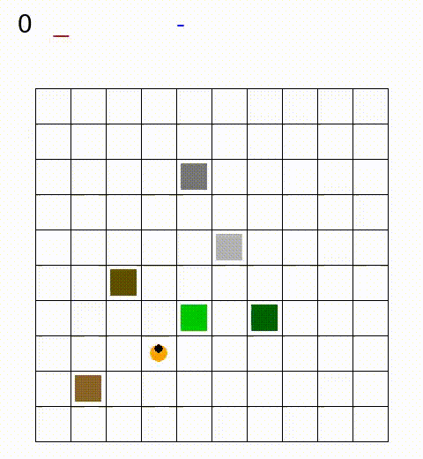

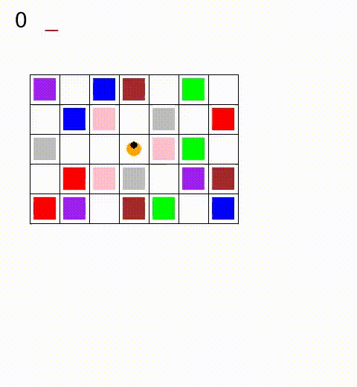
CASE STUDIES
Minecraft
Breakout
Sapientino
Fabian Fonseca - Case Studies

Slide 30

Breakout analysis
—GOAL
—EXPERT
—LEARNER
Destroy the bricks from the left column to the right column
The way in which the agent interacts with the environment changes!!!
Uses a gun to fire bullets to the bricks. It can be considered handicap
It has to use a ball to break the brick in with a more complex dynamic
Fabian Fonseca - Case Studies

Slide 31
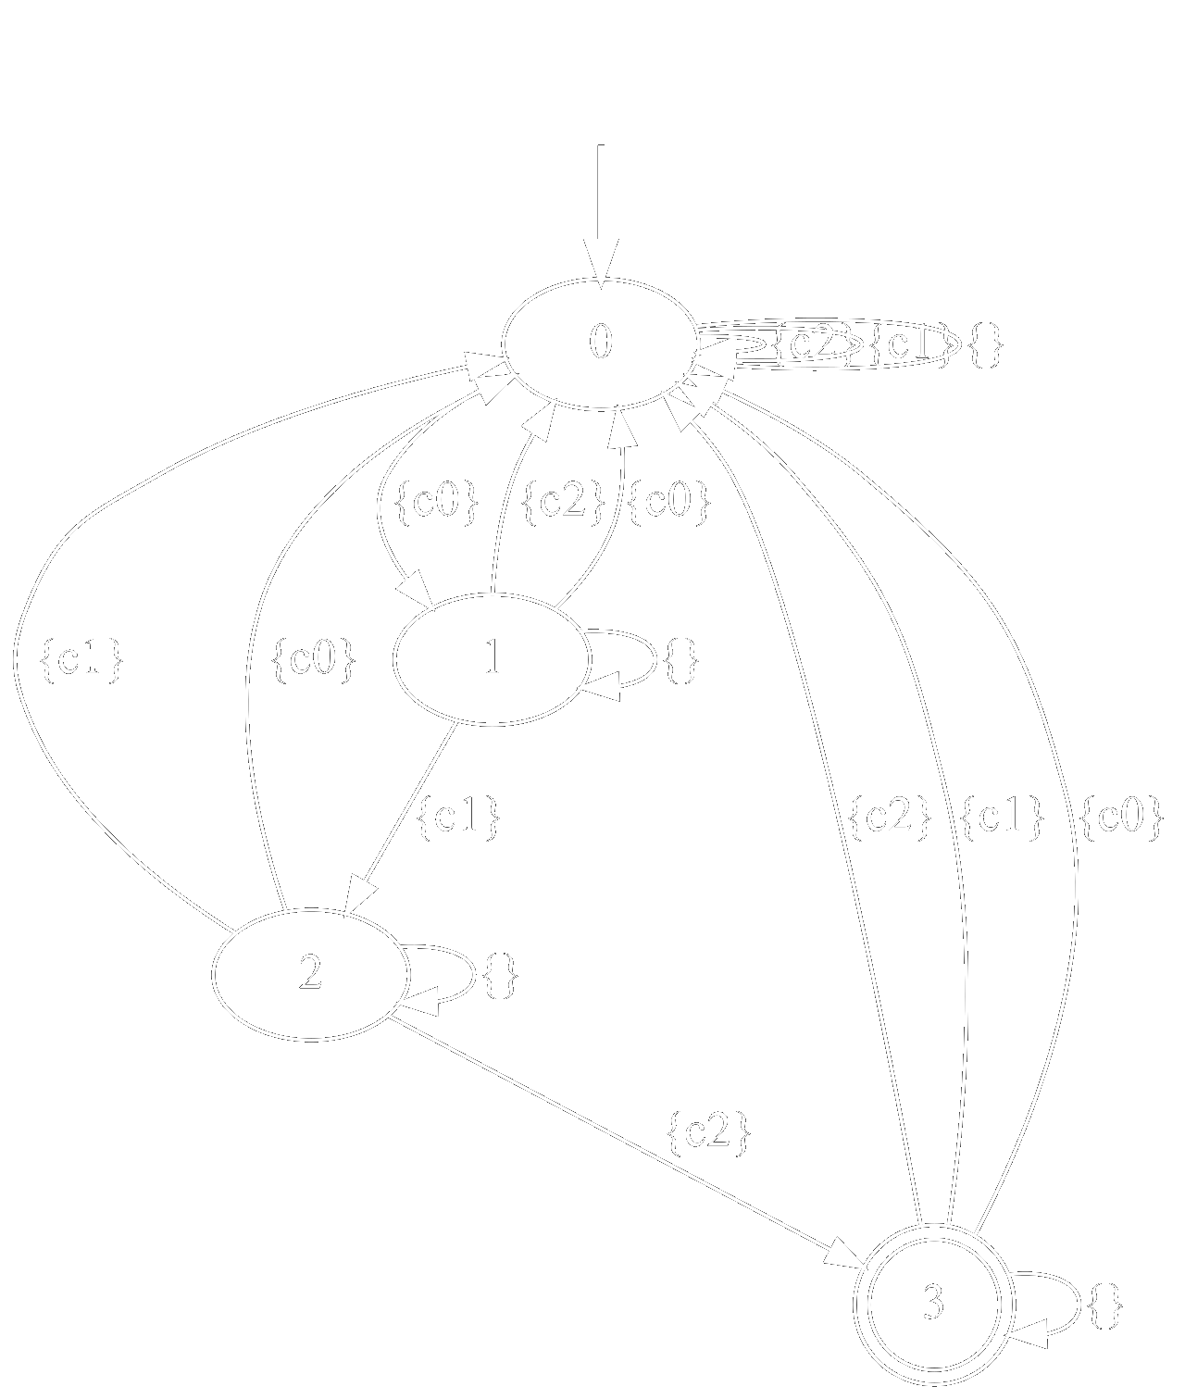
Generating the DFA
Positive
Negative
c0;c1;c2
c0;c1;c2
c0;c1;c2
c0;c1;c2
c0;c1;c2
c0;c1;c2
c0;c1;c2
c0;c1;c2
c0;c1;c2
c0;c1;c2
c1;c0;c2
c1;c2
c1;c2
c0;c2;c1
c2;c1
c1;c2;c0
c2;c1
c1;c2;c0
c2;c1;c0
c2;c1
L*
Now we can send it to the lerner . . .
Fabian Fonseca - Case Studies

Slide 32



Breaking the game
Easy
Medium
Hard
Bricks in movement along the X-Axis. It fails a few shots but is able to finish.
Bricks in movement along the Y-Axis. It is the same for the expert.
Bricks in movement along the XY-Plane. It fails to finish the task.
Fabian Fonseca - Implemented Alternative

Slide 33


Generalization of the DFA
—TRUE DFA
—GENERALIZED DFA
Traces L*
DFA send to the lerner . . .
Fabian Fonseca - Obtained DFA

Slide 34


The Learned Agents + RB
It is able to team up with the second paddle to get more reward
Despite the XY-Plane movement, it learned how to solve the task
Fabian Fonseca - Learned Agents

Slide 35
Conclusions
The approach presented in the paper, is able to perform Imitation Learning between heterogeneous agents with different state spaces.
The implementation manages to use Inverse Reinforcement Learning to represent the experts behaviour in form of a DFA.
Experimenting across several cases of study proves the effectiveness and robustness of the approach.
Given enough traces, the learner agent is capable of outperform a failed expert like in this specific case.

Slide 36
References
[1] De Giacomo, Giuseppe, et al. “Imitation Learning over Heterogeneous Agents with Restraining Bolts.” Association for the Advancement of Artificial Intelligence. 2020.
[2] Gaon, Brafman. “Reinforcement Learning with Non-Markovian Rewards.” Association for the Advancement of Artificial Intelligence. 2020.
* Template by Slidesgo * Icons by Flaticon

Slide 37


